Slide 1
FESTIVALES DE ESPAÑA
Las Fallas, La fiesta de La Valencia

Slide 2
THE CELEBRATION
Every March Valencia gets ready to welcome the spring. The streets fill up with joy and the hustle and bustle of the Fallas festival, the upmost expression of the merger of tradition, satire, art and sentimentality for one's homeland. The Valencian people live their most international fiesta to the maximum and their kind and natural character invites you to visit the city and join in this fiesta, where everything that is bad is burnt and reborn from the ashes to welcome a new season.

Slide 3
This is Why You Will Love Las Fallas
The festivities program for the Fallas Week originates from the heart of the Fallas process. An example of it is the “ninot indultat” (pardoned ninot), a tradition that was asked for by the people. This lead to an exhibition of the best figures, one per Falla, with the general public as the jury, and these were saved from being burnt. All the pardoned ninots are exhibited in the Fallas Museum.
Mascletà
La plantà
Fireworks and the Nit del Foc
Ofrenda de Flores (Offering of Flowers)
La Cremà (The Burning)

Slide 4
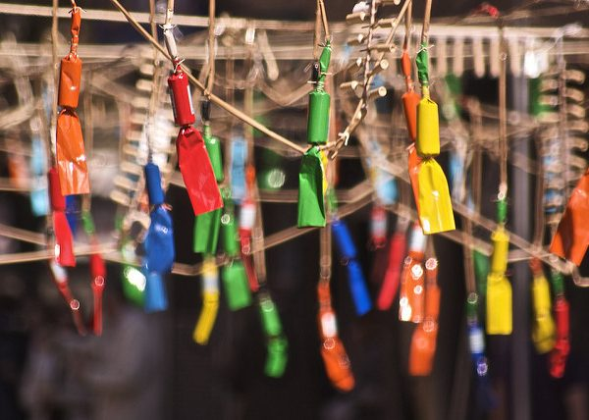
Mascletà
From 1 to 19 March, every day at 2 pm in the Plaza del Ayuntamiento, the city vibrates to the sound of the traditional mascletà, a display of gunpowder explosions that beats out a unique sound. Afterwards, the city’s terraces fill up as people go to enjoy a typical aperitif and some traditional Valencian food under the Mediterranean sun.

Slide 5
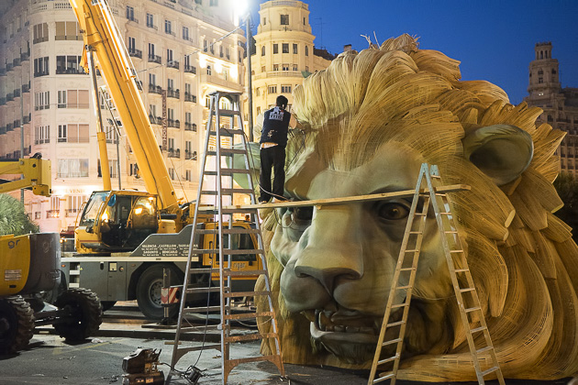
La plantà
On the night of 15 to 16 March the plantà (installation) takes place, when the falleros and falleras, the men and women who construct the fallas (monuments), get together to work through the night on erecting them, to have them finished by dawn on the 16th.

Slide 6
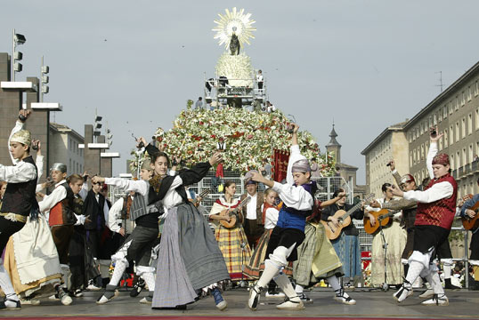
Offrenda de Flores
All of the city’s fallas commissions will take place in a parade from their respective districts to the Plaza de la Virgin in order to make an offering of flowers to Our Lady of the Forsaken, the Patron Saint of Valencia. The celebration takes place from 4 pm until past nightfall. With all of the bunches of flowers given by the falleras to the Virgin, an impressive 15 metre-high tapestry is formed on the main façade of the Basilica and a mantle is made for the Virgin.

Slide 7
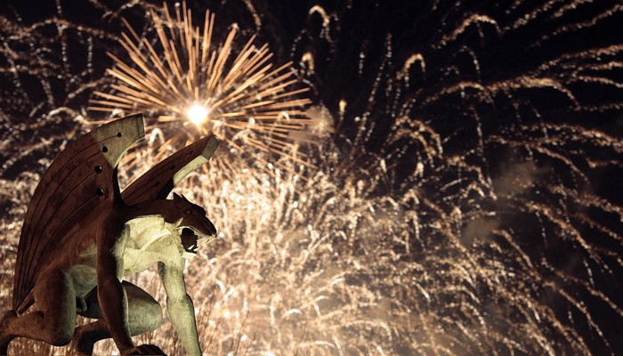
Fireworks and Nit del Foc
Every night from 15 to 18 March, the sky of Valencia is filled with the light and colour of impressive firework displays. At 12 midnight, people gather on Paseo de la Alameda to enjoy the best display of colour and light. Not to mention the spectacular Nit del foc (Night of Fire), which is held during the early hours of the 18th and offers a fireworks display which is the only one of its kind in the world.

Slide 8
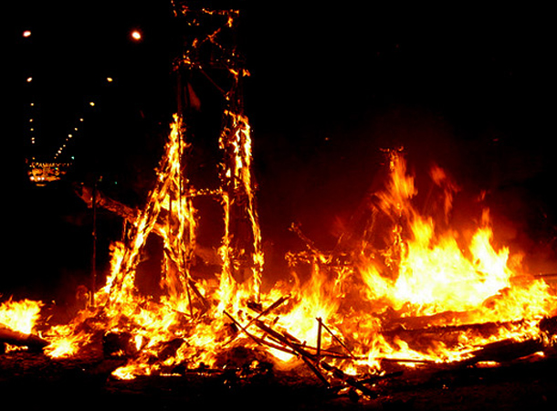
La Cremà (The Burning)
On 19 March all of the sculptures, both those in the large and the children’s categories, go up in flames. At 10 pm the Cremà of the children’s sculptures begins. Two hours later it is the turn of the large monuments. The falla in the Plaza del Ayuntamiento is the last one to burn, at 1 am in the morning. It is always preceded by a small display of spectacular fireworks which fill the square with noise, light and colour, leading to the Cremà of the city’s last falla and with it the end of the festival

Slide 9
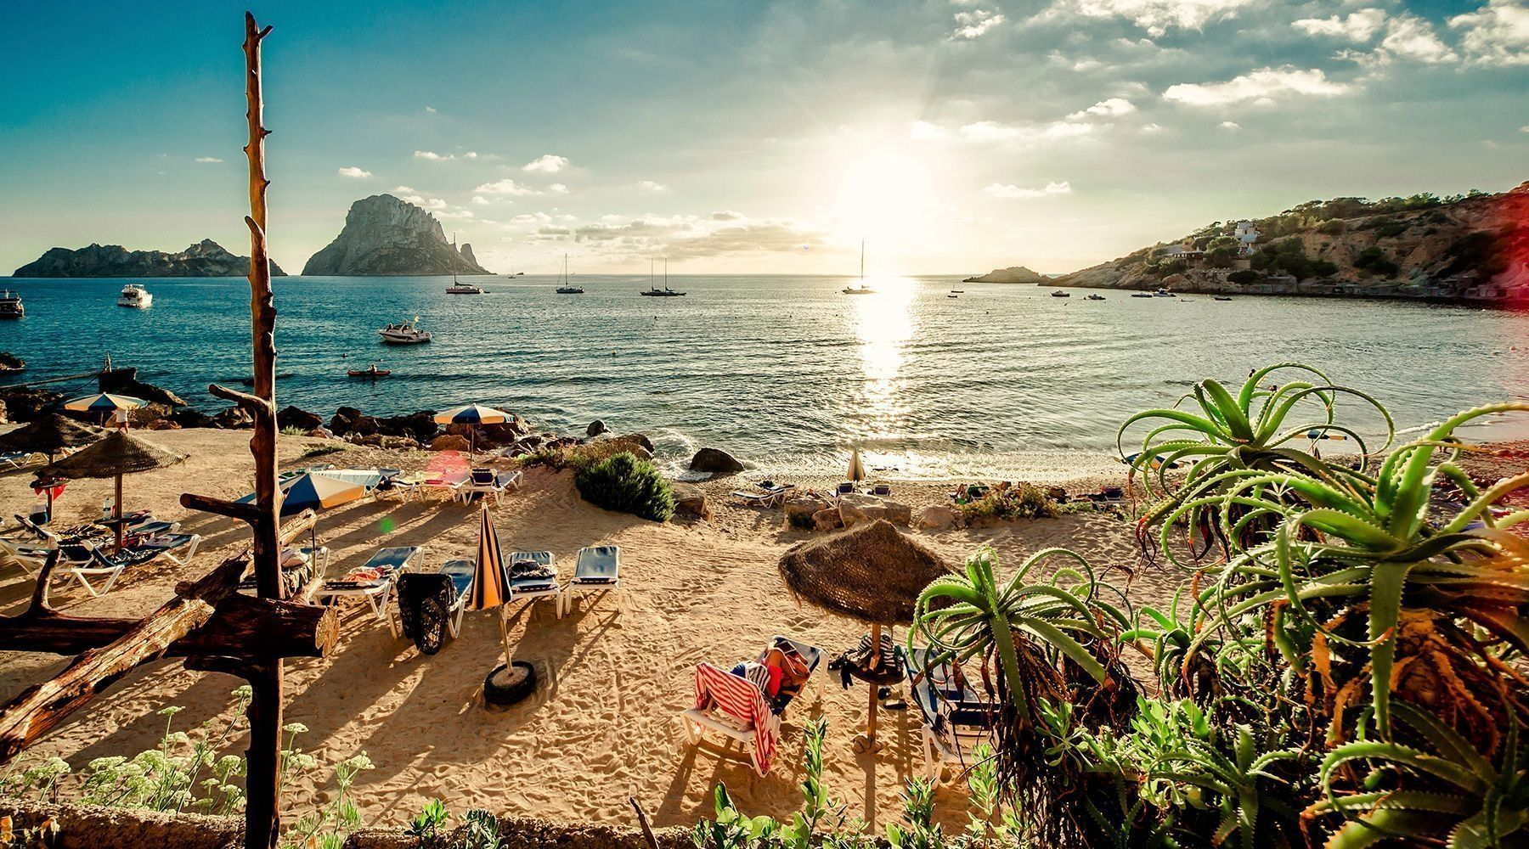
WELCOME TO VALENCIA

